Slide 1

SMART GLOVE FOR Health monitoring
Presented By : Vishal Verma
Kajal Pathak
Nishant Kr. Patel
Ujjawal Chandela

Slide 2
Contents
Motivation
Introduction
Objectives
Hardware & Software Requirement
Specifications
Pin Diagrams
Block Diagram of the System
System Design
Programming Logic
Coding
Results
Conclusions
References
Research Paper

Slide 3
Motivation
Areas affected with highly contagious diseases like covid-19 requires remote health monitoring facilities which are inexpensive and easy to operate Remote monitoring of the patients condition also saves the precious time of both the patient and doctors and it is preferred in rural areas as well as for old patients.

Slide 4


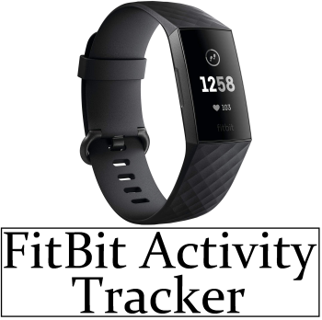
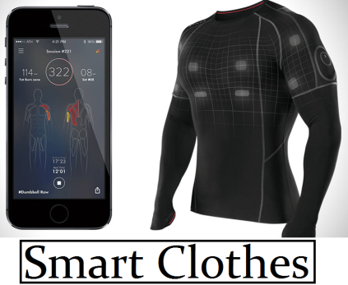
Introduction
Wearable technologies are now, an integral part of our life, they live on our wrist , our glasses ,track our activities and take us to the virtual world.
Wearable technology is a small portable computer that is designed to be worn on the body during use. Perform calculations and process information on the wearer
These computer are usually either integrated into the user’s clothing or attach to the body through any other means.
The technology is designed in such a way that it does not interfere with the daily task.

Slide 5
Wearable technology plays a prominent role in today’s health care transformation.
In the medical field, wearable tech could be used to monitor the vital science, minor diseases and monitor the patient at all time or during a epidemic or global pandemic.
For security and safety purposes, it can be used in military to provide environment surveillance, remote team monitoring and real time data acquisition.
In the field of Sports and Fitness, devices can be made for physiology monitoring, sports performance ,posture monitoring, etc to provide insights and prevent injuries.

Slide 6

Objectives
To design Glove for monitoring :
Patient’s Pulse Rate Per Minute
Body Temperature
Display the readings
Connect the Smart Glove With IOT Platform For Monitoring Patient Health Remotely

Slide 7
Some Examples
Several wearable systems [1] have been reported in the literature to monitor the health and diagnosing the patients with arthritis, heart diseases etc.
Kumar K R et.al [2] proposed a sensor loaded glove with a complete unit to assist paralytic patients. The system converted the finger bending of the patient into auditory speech.
Luay Fraiwan et.al[3] proposed a glove for monitoring mental health. The primary function of this glove was to continuously monitor changes in skin temperature, galvanic skin resistance, and heart rate variability.

Slide 8
G. Mahammad Gouse et.al[4] proposed a wearable system for hand gesture recognition.
Ribin Jones S.B et.al[5] designed a health Monitoring wearable glove which can be worn and used to display the heart rate of any individual on the display mounted on the glove.

Slide 9
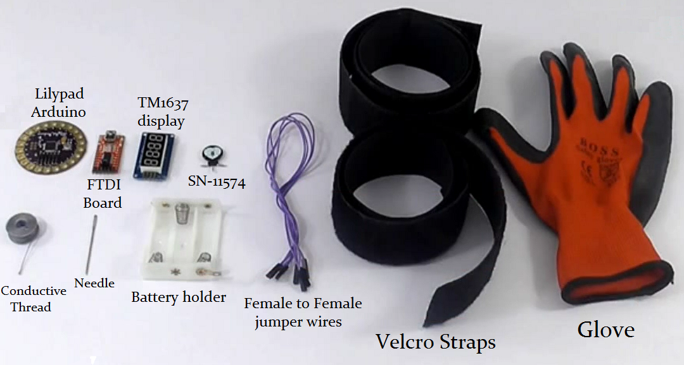
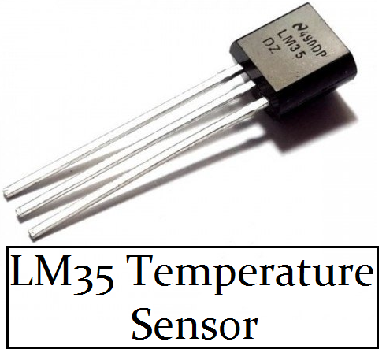
Hardware Required
.
Lilypad Arduino
TM1637 display
FDTI Board
LM35 Sensor
SN-11574 Sensor
Wi-Fi Module(Node MCU)
Glove
Conducting Thread and other accessories

Slide 10
Software Required
Arduino IDE
Arduino IDE, the development environment of the Arduino where code is to be written before it can be uploaded on the board.
Go to the Arduino download page and download the latest version of the Arduino software for Windows.
When the download is finished, un-zip it and open up the Arduino folder to confirm that yes, there are indeed some files and sub-folders inside.
Power up your Arduino by connecting your Arduino board to your computer with a USB cable (or FTDI connector if you're using an Arduino pro). You should see that an LED on board is 'ON' light up.

Slide 11
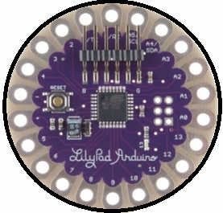
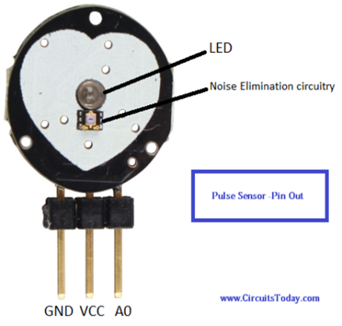
Specifications
Lilypad ARDUINO
Advanced RISC Architecture
6 PWM channels
Programmable Serial USART
External & Internal Interrupt Sources
Operating Voltage 2.7V-5.5V
On-chip Analog Comparator
8-channel ADC with 10-bit accuracy
14 digital I/O pins
Pulse Sensor (SN-11574)
Biometric Pulse Rate or Heart Rate detecting sensor
Plug and Play type sensor
Operating Voltage: +5V or +3.3V
Current Consumption: 4mA
Inbuilt Amplification and Noise cancellation circuit.
Diameter: 0.625”
Thickness: 0.125” Thick

Slide 12
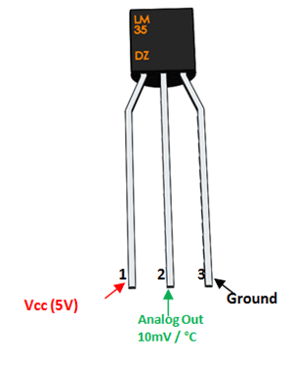
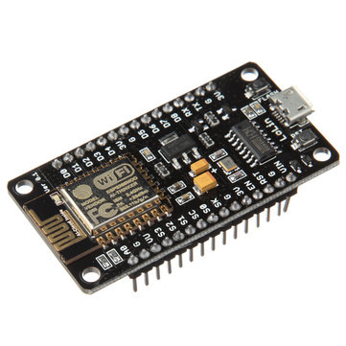
Specifications - Contd
LM35 Temperature Sensor
Calibrated directly in ˚Celsius
Linear + 10.0 mV/˚C scale factor
0.5˚C accuracy (at +25˚C)
Rated for full −55˚ to +150˚C range
Operates from 4 to 30 volts
Less than 60 µA current drain
Low self-heating, 0.08˚C in still air
NodeMCU - Wi-Fi Module
Microcontroller: Tensilica 32-bit RISC CPU Xtensa LX106
Operating Voltage: 3.3V
Input Voltage: 7-12V
Digital I/O Pins (DIO): 16
Analog Input Pins (ADC): 1
ESP8266 Wi-Fi module
UARTs: 1
SPIs: 1
Flash Memory: 4 MB
SRAM: 64 KB
Clock Speed: 80 MHz
Wi-Fi: IEEE 802.11 b/g/n

Slide 13
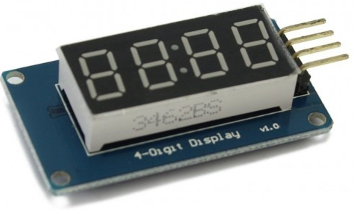
Specifications - Contd
TM1637 Display module
Two wire interface
Eight adjustable luminance levels
Grove compatible interface (3.3V/5V)
Four alpha-numeric digits
Potable size
Operating voltage: 3.3V – 5.5V
Operating current consumption: 80mA
Operating temperature: -10ºC to +80ºC

Slide 14
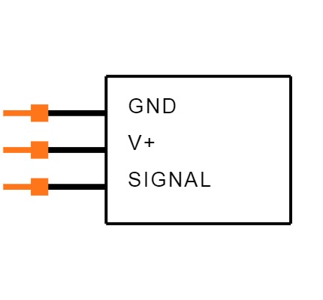
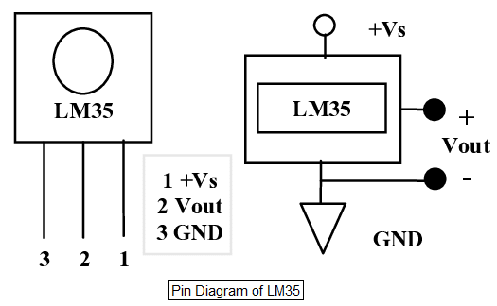
Pin Diagrams
.
Pin diagram of SN-11574
Pin Number | Pin Name | Description
1 | Ground | Connected to the ground of the system
2 | Vcc | Connect to +5V or +3.3V supply voltage
3 | Signal | Pulsating output signal.
Pin diagram of LM 35
Pin Number | Pin Name | Description
1 | Vcc | Input voltage is +5V
2 | Analog Out | Increase in 10mV for raise of every 1°C. Range from -1V(-55°C) to 6V(150°C)
3 | Ground | Connected to ground of circuit

Slide 15
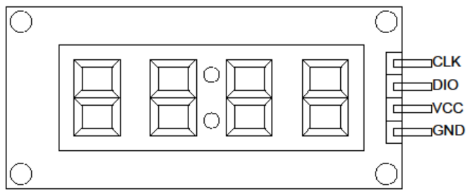
Pin diagram of TM1637
Pin Number | Pin Name | Description
1 | CLK | Clock Pin
2 | DIO | Data I/O pin
3 | VCC | 5V
4 | GND | Ground

Slide 16
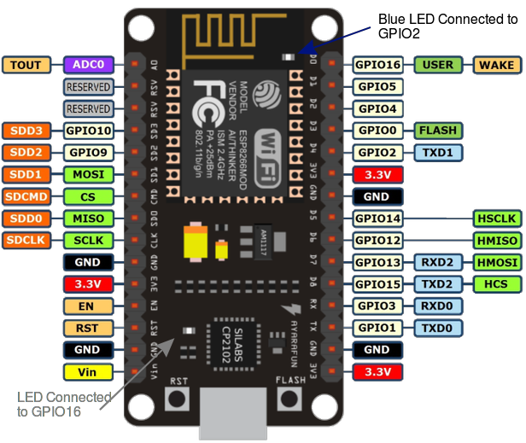
.
Pin diagram of Node MCU

Slide 17
.
Label | GPIO | Input | Output | Notes
D0 | GPIO16 | no interrupt | no PWM or I2C support | HIGH at boot used to wake up from deep sleep
D1 | GPIO5 | OK | OK | often used as SCL (I2C)
D2 | GPIO4 | OK | OK | often used as SDA (I2C)
D3 | GPIO0 | pulled up | OK | connected to FLASH button, boot fails if pulled LOW
D4 | GPIO2 | pulled up | OK | HIGH at boot connected to on-board LED, boot fails if pulled LOW
D5 | GPIO14 | OK | OK | SPI (SCLK)

Slide 18
Label | GPIO | Input | Output | Notes
D6 | GPIO12 | OK | OK | SPI (MISO)
D7 | GPIO13 | OK | OK | SPI (MOSI)
D8 | GPIO15 | pulled to GND | OK | SPI (CS) Boot fails if pulled HIGH
RX | GPIO3 | OK | RX pin | HIGH at boot
TX | GPIO1 | TX pin | OK | HIGH at boot debug output at boot, boot fails if pulled LOW
A0 | ADC0 | Analog Input | X
The pins highlighted in green are OK to use. The ones highlighted in yellow are OK to use, but needed to pay attention because they may have unexpected behaviour mainly at boot.

Slide 19
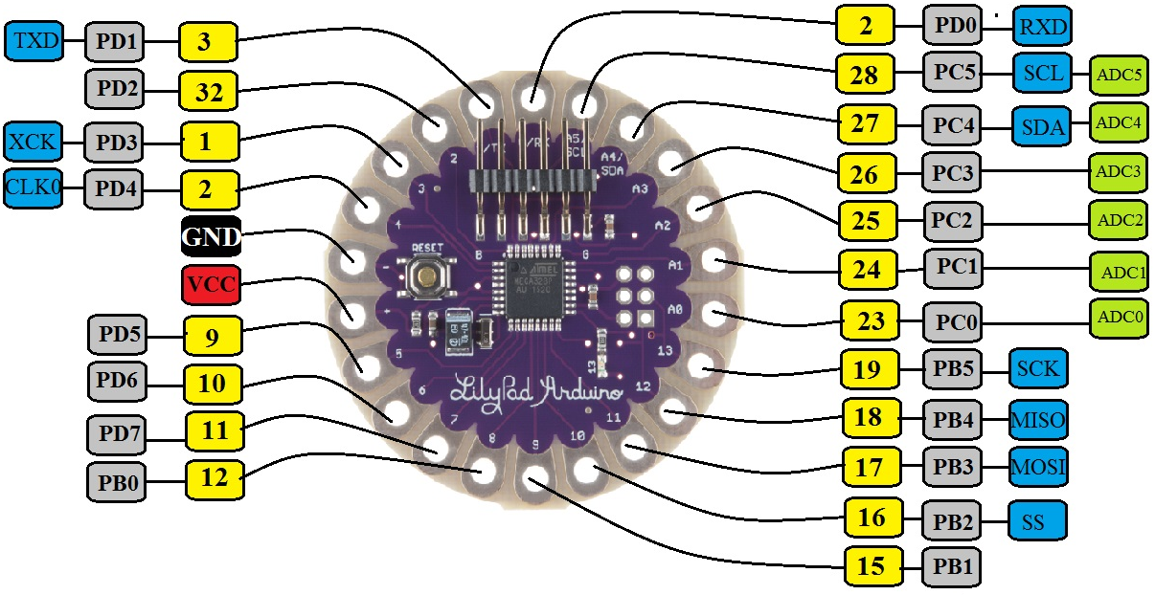
Pin diagram of Lilypad Arduino

Slide 20
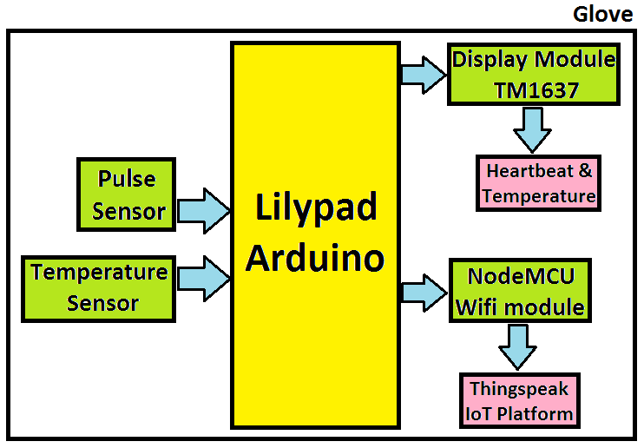
Block Diagram of the System
.
As soon as a Pulse is detected a voltage can be seen which when amplified and smoothened is converted into a digital value By Lilypad Arduino
The Temperature Sensor gives a similar analog output in voltage and that is too converted into a digital value by an A/D converter present on Lilypad Arduino
Both of these values are then printed on Display module follow in sequence after a set delay and alongside the data is sent to an online platform

Slide 21
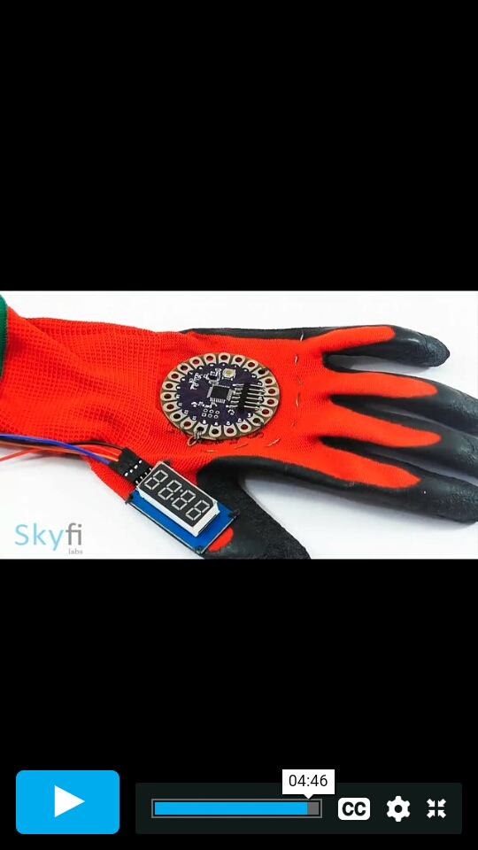
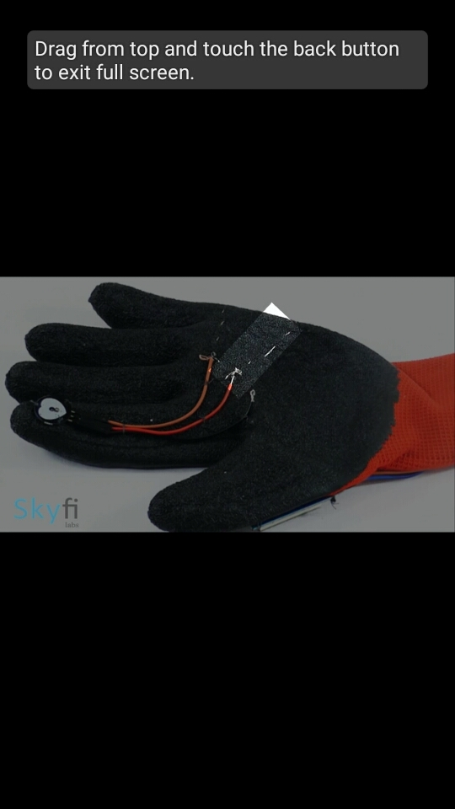
System Design
.
Interfaced Temperature Sensor with LilyPad
Interfaced Pulse Sensor with Lilypad
Interfaced LCD Display with LilyPad
Integrated all the Components on Glove
Components Sewn onto the glove.
Components connected using the conductive thread.
Cross Connected using Conductive thread.
Placed the battery holder and sewn everything tight.

Slide 22
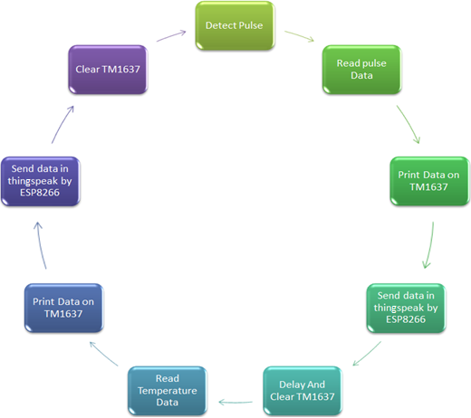
Programming Logic
.

Slide 23
Programming Logic
Pulse sensor ,detects the pulse based on the threshold value set for it, using sawStartOfBeat() function.
Once the pulse is detected, data is read in beats/minute using getBeatsPerMinute() function.
This data is printed on TM1637 display module using
display.print() function and immediately sent on ThingSpeak via ESP8266
Once the data is displayed, display is cleared soon after
This cycle is repeated for after each 2 seconds or whenever the pulse is detected for a set time.

Slide 24
Programming Logic Contd..
After set time Data from LM35 Temperature sensor is taken too for a set time
A stabilised Data Reading from temperature sensor is detected and fed to TM1637 display module using display.print() function and immediately sent on ThingSpeak via ESP8266
Display is cleared soon after and process repeated again for set time

Slide 25
Coding
.
#include <LiquidCrystal.h>
LiquidCrystal lcd(12, 11, 5, 4, 3, 2);
#include <SoftwareSerial.h>
float pulse = 0;
float temp = 0;
SoftwareSerial ser(9,10);
String apiKey = "SNX3F6OPUW50DUL9";
String ssid = “ujjawal";
String pass = “xkcdhatguy2037";
//Variables
int pulsePin = A0;
//Pulse Sensor purple wire connected to analog pin 0
int blinkPin = 7 ; //pin to blink led at each beat
int fadePin = 13; //pin to do fancy classy fading blink at each beat
int fadeRate = 0; //used to fade LED on with PWM on fadePin
//Volatile Variables, used in the interrupt service routine!
volatile int BPM; //int that holds raw Analog in 0. updated every 2mS
volatile int Signal; //holds the incoming raw data
volatile int IBI = 600; //int that holds the time interval between beats!
volatile boolean Pulse = false; //"True" when User's live heartbeat is detected. //"False" when nota "live beat".
volatile boolean QS = false; //becomes true when Arduoino finds a beat.
//Regards Serial OutPut -- Set This Up to your needs
static boolean serialVisual = true; //Set to 'false' by Default. Re-set to 'true' to see Arduino //Serial Monitor ASCII Visual Pulse
volatile int rate[10]; //array to hold last ten IBI values
volatile unsigned long sampleCounter = 0; //used to determine pulse timing
volatile unsigned long lastBeatTime = 0; //used to find IBI
volatile int P = 512; //used to find peak in pulse wave, seeded
volatile int T = 512; //used to find trough in pulse wave, seeded

Slide 26
Coding
.
volatile int thresh = 525; //used to find instant moment of heart beat, seeded
volatile int amp = 100; //used to hold amplitude of pulse waveform, seeded
volatile boolean firstBeat = true; //used to seed rate array so we startup with reasonable BPM
volatile boolean secondBeat = false; //used to seed rate array so we startup with reasonable BPM
void setup()
{
lcd.begin(16, 2);
pinMode(blinkPin,OUTPUT); //pin that will blink to your heartbeat!
pinMode(fadePin,OUTPUT); //pin that will fade to your heartbeat!
Serial.begin(115200); //we agree to talk fast!
interruptSetup(); //sets up to read Pulse Sensor signal every 2mS
lcd.clear();
lcd.setCursor(0,0);
lcd.print(" Patient Health");
lcd.setCursor(0,1);
lcd.print(" Monitoring ");
delay(4000);
lcd.clear();
lcd.setCursor(0,0);
lcd.print("Initializing....");
delay(5000);
lcd.clear();
lcd.setCursor(0,0);
lcd.print("Getting Data....");
ser.begin(9600);
ser.println("AT");
delay(1000);
ser.println("AT+GMR");
delay(1000);
ser.println("AT+CWMODE=3");
delay(1000);
ser.println("AT+RST");
delay(5000);

Slide 27
Coding
.
ser.println("AT+CIPMUX=1");
delay(1000);
String cmd="AT+CWJAP=\"Alexahome\",\"98765432\"";
ser.println(cmd);
delay(1000);
ser.println("AT+CIFSR");
delay(1000);
} void loop()
{ serialOutput();
if (QS == true) //A Heartbeat Was Found
{
//BPM and IBI have been Determined Quantified Self "QS" true when arduino finds a heartbeat
fadeRate = 255; //Makes the LED Fade Effect Happen, //Set 'fadeRate' Variable to 255 to fade LED with pulse
serialOutputWhenBeatHappens(); //A Beat Happened, Output that to serial.
QS = false; //reset the Quantified Self flag for next time
}
ledFadeToBeat(); //Makes the LED Fade Effect Happen
delay(20); //take a break
read_temp();
esp_8266();
}
void ledFadeToBeat()
{
fadeRate -= 15; //set LED fade value
fadeRate = constrain(fadeRate,0,255); //keep LED fade value from going into negative numbers!
analogWrite(fadePin,fadeRate); //fade LED
}
void interruptSetup()
{//Initializes Timer2 to throw an interrupt every 2mS.
TCCR2A = 0x02; //DISABLE PWM ON DIGITAL PINS 3 //AND 11, AND GO INTO CTC MODE
TCCR2B = 0x06; //DON'T FORCE COMPARE, 256 PRESCALER
OCR2A = 0X7C; //SET THE TOP OF THE COUNT TO //124 FOR 500Hz SAMPLE RATE
TIMSK2 = 0x02; //ENABLE INTERRUPT ON MATCH //BETWEEN TIMER2 AND OCR2A

Slide 28
Coding
.
sei(); //MAKE SURE GLOBAL INTERRUPTS ARE ENABLED
}
void serialOutput()
{ //Decide How To Output Serial.
if (serialVisual == true)
{
arduinoSerialMonitorVisual('-', Signal); //goes to function that makes Serial Monitor Visualizer
}
else
{
sendDataToSerial('S', Signal); //goes to sendDataToSerial function
}
}
void serialOutputWhenBeatHappens()
{
if (serialVisual == true)
//Code to Make the Serial Monitor Visualizer Work
{
Serial.print("*** Heart-Beat Happened *** "); //ASCII Art Madness
Serial.print("BPM: ");
Serial.println(BPM);
}
else
{
sendDataToSerial('B',BPM); //send heart rate with a 'B' prefix
sendDataToSerial('Q',IBI); //send time between beats with a 'Q' prefix
}
}
void arduinoSerialMonitorVisual(char symbol, int data )
{const int sensorMin = 0; //sensor minimum, discovered through experiment
const int sensorMax = 1024; //sensor maximum, discovered through experiment
int sensorReading = data; //map the sensor range to a range of 12 options:
int range = map(sensorReading, sensorMin, sensorMax, 0, 11);
//do something different depending on the
//range value:

Slide 29
Coding
.
switch (range)
{
case 0:
Serial.println(""); /////ASCII Art Madness
break;
case 1:
Serial.println("---");
break;
case 2:
Serial.println("------");
break;
case 3:
Serial.println("---------");
break;
case 4:
Serial.println("------------");
break;
case 5:
Serial.println("--------------|-");
break;
case 6:
Serial.println("--------------|---");
break;
case 7:
Serial.println("--------------|-------");
break;
case 8:
Serial.println("--------------|----------");
break;
case 9:
Serial.println("--------------|----------------");
break;
case 10:
Serial.println("--------------|-------------------");
break;
case 11:
Serial.println("--------------|-----------------------");
break;
}
}
void sendDataToSerial(char symbol, int data )
{Serial.print(symbol);
Serial.println(data);
}

Slide 30
Coding
.
ISR(TIMER2_COMPA_vect)
//triggered when Timer2 counts to 124
{
cli(); //disable interrupts while we do this
Signal = analogRead(pulsePin); //read the Pulse Sensor
sampleCounter += 2;
//keep track of the time in mS with this variable
int N = sampleCounter - lastBeatTime;
//monitor the time since the last beat to avoid noise
//find the peak and trough of the pulse wave
if(Signal < thresh && N > (IBI/5)*3)
//avoid dichrotic noise by waiting 3/5 of last IBI
{
if (Signal < T) //T is the trough
{
T = Signal; //keep track of lowest point in pulse wave
}
}
if(Signal > thresh && Signal > P)
{ //thresh condition helps avoid noise
P = Signal; //P is the peak
} //keep track of highest point in pulse wave
//NOW IT'S TIME TO LOOK FOR THE HEART BEAT
//signal surges up in value every time there is a pulse
if (N > 250)
{ //avoid high frequency noise
if ( (Signal > thresh)&&(Pulse == false)&&(N>(IBI/5)*3) )
{
Pulse = true;
//set the Pulse flag when we think there is a pulse
digitalWrite(blinkPin,HIGH); //turn on pin 13 LED
IBI = sampleCounter - lastBeatTime; //measure time between beats in mS
lastBeatTime = sampleCounter;
//keep track of time for next pulse
if(secondBeat)
{ //if this is the second beat, if secondBeat == TRUE
secondBeat = false; //clear secondBeat flag
for(int i=0; i<=9; i++) //seed the running total to get a realisitic BPM at startup
{
rate[i] = IBI;
}
}

Slide 31
Coding
.
if(firstBeat) //if it's the first time we found a beat
{
firstBeat = false; //clear firstBeat flag
secondBeat = true; //set the second beat flag
sei(); //enable interrupts again
return; //IBI value is unreliable so discard it
}
//keep a running total of the last 10 IBI values
word runningTotal = 0; //clear the runningTotal variable
for(int i=0; i<=8; i++)
{ //shift data in the rate array
rate[i] = rate[i+1]; //and drop the oldest IBI value
runningTotal += rate[i]; //add up the 9 oldest IBI values
}
rate[9] = IBI; //add the latest IBI to the rate array
runningTotal += rate[9];
//add the latest IBI to runningTotal
runningTotal /= 10; //average the last 10 IBI values
BPM = 60000/runningTotal;
//how many beats can fit into a minute? that's BPM!
QS = true; //set Quantified Self flag
//QS FLAG IS NOT CLEARED INSIDE THIS ISR
pulse = BPM;
}
}
if (Signal < thresh && Pulse == true)
{ //when the values are going down, the beat is over
digitalWrite(blinkPin,LOW); //turn off pin 13 LED
Pulse = false; //reset the Pulse flag so we can do it again
amp = P - T; //get amplitude of the pulse wave
thresh = amp/2 + T; //set thresh at 50% of the amplitude
P = thresh; //reset these for next time
T = thresh;
}
if (N > 2500)
{ //if 2.5 seconds go by without a beat
thresh = 512; //set thresh default
P = 512; //set P default
T = 512; //set T default
lastBeatTime = sampleCounter;
//bring the lastBeatTime up to date
firstBeat = true; //set these to avoid noise
secondBeat = false; //when we get the heartbeat back
}
sei(); //enable interrupts when youre done!
}//end isr

Slide 32
Coding
.
void esp_8266()
{
//TCP connection AT+CIPSTART=4,"TCP","184.106.153.149",80
String cmd = "AT+CIPSTART=4,\"TCP\",\"";
cmd += "184.106.153.149"; //api.thingspeak.com
cmd += "\",80";
ser.println(cmd);
Serial.println(cmd);
if(ser.find("Error"))
{
Serial.println("AT+CIPSTART error");
return;
}
String getStr = "GET /update?api_key=";
getStr += apiKey;
getStr +="&field1=";
getStr +=String(temp);
getStr +="&field2=";
getStr +=String(pulse);
getStr += "\r\n\r\n";
//send data length
cmd = "AT+CIPSEND=4,";
cmd += String(getStr.length());
ser.println(cmd);
Serial.println(cmd);
delay(1000);
ser.print(getStr);
Serial.println(getStr);
//thingspeak needs 15 sec delay between updates
delay(3000);
} void read_temp()
{
int temp_val = analogRead(A1);
float mv = (temp_val/1024.0)*5000;
float cel = mv/10;
temp = (cel*9)/5 + 32;
Serial.print("Temperature:");
Serial.println(temp);
lcd.clear();
lcd.setCursor(0,0);
lcd.print("BPM :");
lcd.setCursor(7,0);
lcd.print(BPM);
lcd.setCursor(0,1);
lcd.print("Temp.:");
lcd.setCursor(7,1);
lcd.print(temp);
lcd.setCursor(13,1);
lcd.print("F");
}

Slide 33
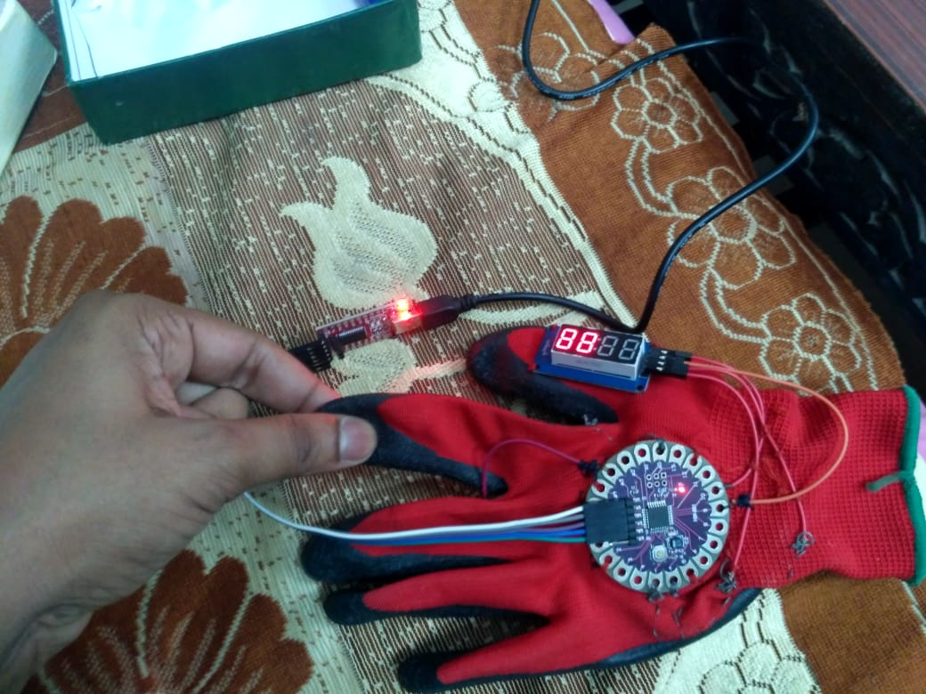
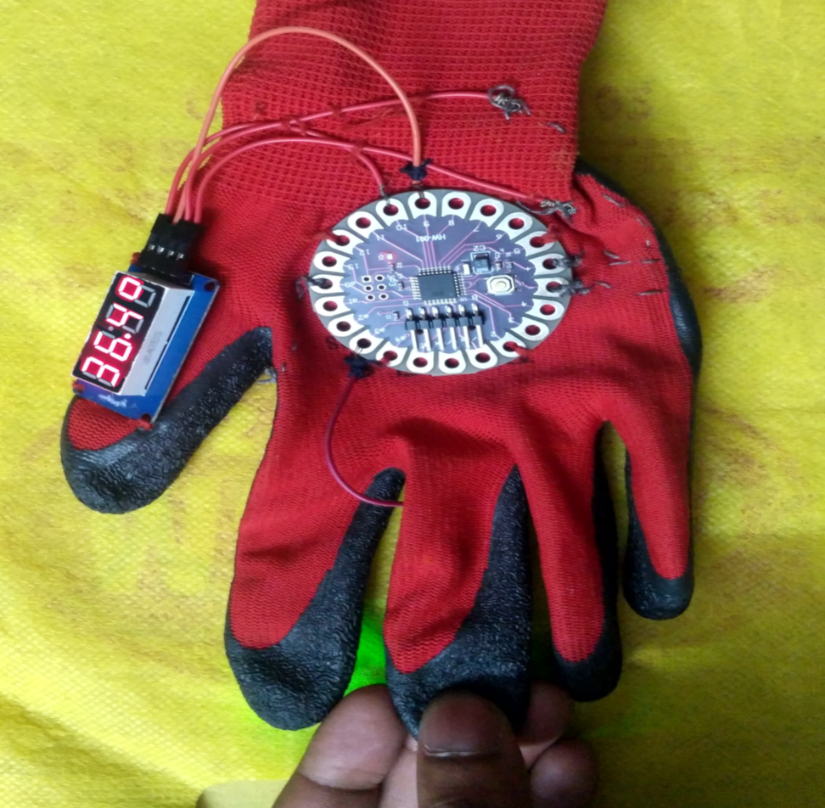
Outputs & Testing
Heart Beat & Temperature

Slide 34
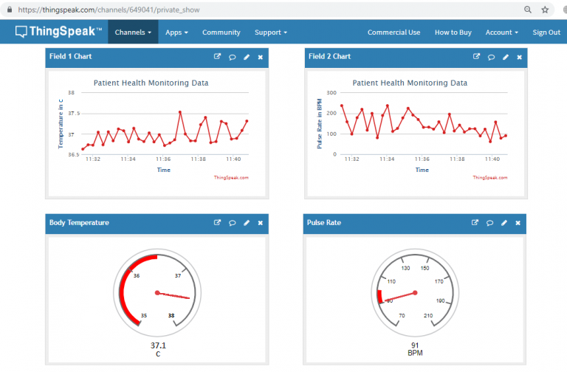
Uploading on ThingSpeak
<<

Slide 35
Result
Heart beat
for average pulse rate for a 30 year old healthy person are as follows:
The range of heart rate is calculated by removing the age from 220.i.e: 220 – 30 = 190.
50 percent: 190 x 0.50 = 95 bpm
85 percent: 190 x 0.85 = 162 bpm Being tested on a 21 years old person; the average calculated heartbeat range must be within 99.5 to 169.5 bpm, because =220-21=199
Minimum Heart rate=0.5*199=99.5 bpm
Maximum Heart rate=0.85*199=169.5 bpm
Temperature
LM35 senses the heat from the body and converts it into the voltage output in millivolts (Vout). After some internal processing the temperature is displayed in digital format over the proposed display.
The final reading of temperature sensor displayed on the 7-segment display was 36.4ᶛC.
ThingSpeak
processed data after display is transmitted to the ThingSpeak Server using ESP8266 wifi module for remote access and monitoring

Slide 36
Progress during pandemic
Lilypad Arduino replaced with Arduino Uno to facilitate more pins for future enhancement in the current model for Smart health monitoring glove.
TM1637 display replaced with LCD 1602 display to distinctively show Heart rate and temperature simultaneously.
NodeMCU replaced with ESP8266 wifi module for better interfacing and avoid unnecessary clumsiness

Slide 37
Conclusions
The implementation and working of a Smart Glove for Health Monitoring is presented
It has low cost, being easily accessible and used for personal health monitoring and is expected for early detection and better treatment of various medical conditions as well as disease prevention and better understanding and self-management of diseases.
This system is very helpful for the remote monitoring of patients staying at home. The system empowers specialists to analyse and distinguish the conditions of versatility and help heart related problem of the patients without expecting them to be Present at the emergency clinic.

Slide 38
References
Selvaraj, Sureshkumar, and Suresh Sundaravaradhan. "Challenges and opportunities in IoT healthcare systems: a systematic review." SN Applied Sciences 2, no. 1 (2020): 139.
Kumara K R, Ankita Kadam, Neha Rane, Shraddha Vernekar, Asma Gouda,"Sensor Based Wearable System to Assist Paralytic Patient with Continuous Health Monitoring" in May,2018
Luay Fraiwan, Tasnim Basmaji, Omnia Hassanin,"A Mobile Mental Health Monitoring System: A Smart Glove" in 2018
Dr. G. Mahammad Gouse, Mir Abdul Samim Ansari, Shubiya Sultana, Swathi Jha, Sruthi Krishna.U, "Advanced Data Peripheral Glove with Real-time Vital Health Monitoring System" in 2017
Ribin Jones S.B, Dr. N. Kumar, Swaraj S Paul, "Health Monitoring Wearable Glove" in September,2018

Slide 39
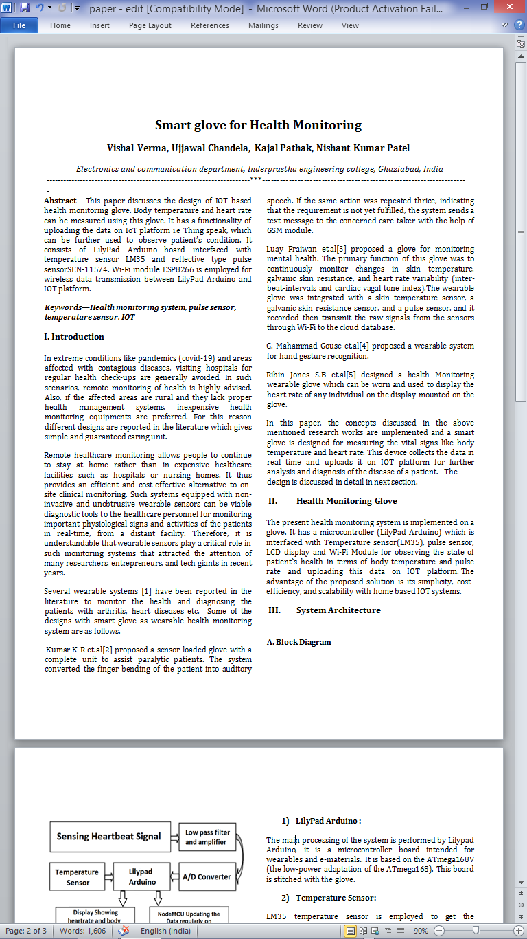
Research Paper
.

Slide 40
THANK YOU

Slide 41
Work Plan
.
S.NO. | PHASE | DURATION | STATUS | REMARKS
1. | Research on wearable technology. | 1 SEPT-15 SEPT | Completed | Learnt wearable technology and its need
2. | Collecting hardware components on the reasonable price | 15 SEPT-30SEPT | Completed | Purchased Lilypad Arduino, FTDI driver, Pulse Sensor & LM35.
3. | Getting started with LilyPad Arduino | 1 OCT-15 OCT | Completed | Learnt LilyPad Arduino and its architecture
4. | Interfacing the pulse sensor & TM1637 module | 15-OCT-25 OCT | Completed | Interfacing the hardware components
5. | Fabrication of glove | 25 OCT-20NOV | Completed | Stitching and connecting parts on the glove
6. | Smart Glove Coding | 10 JAN-31 JAN | Completed | Configuring the various ports of Arduino,

Slide 42
Work Plan
.
S.NO. | PHASE | DURATION | STATUS | REMARKS
7. | Testing the glove | 1 FEB-12 FEB | Completed | Glove is working properly.
8. | Interfacing the LM35 with Lilypad | 13 FEB-26 FEB | Completed | Interfacing and Stitching the component
9. | Updating the code to Lilypad | 27 FEB-8 MAR | Completed | Configuring new ports for the sensor
10. | Getting started with NodeMCU | 9 MAR-22 MAR | Completed | Learnt NodeMCU specifications working and Architecture
11. | Interfacing and coding Node MCU with LilyPad | 23 MAR – 14 APR | pending | Configuring ports for Node MCU in Existing code and interfacing with Lilypad
12. | Connecting to the IoT | 15 APR- 3 MAY | Pending | Data is accessible on ThingSpeak

